Slide 1
Employee Contact Management System​
GROUP -10

Slide 2
CLASS DIAGRAM
Class diagram is a static diagram. It represents the static view of an application. Class diagram is not only used for visualizing, describing, and documenting different aspects of a system but also for constructing executable code of the software application.
Class diagram describes the attributes and operations of a class and also the constraints imposed on the system. The class diagrams are widely used in the modeling of object oriented systems because they are the only UML diagrams, which can be mapped directly with object-oriented languages. Class diagram shows a collection of classes, interfaces, associations, collaborations, and constraints. It is also known as a structural diagram.

Slide 3
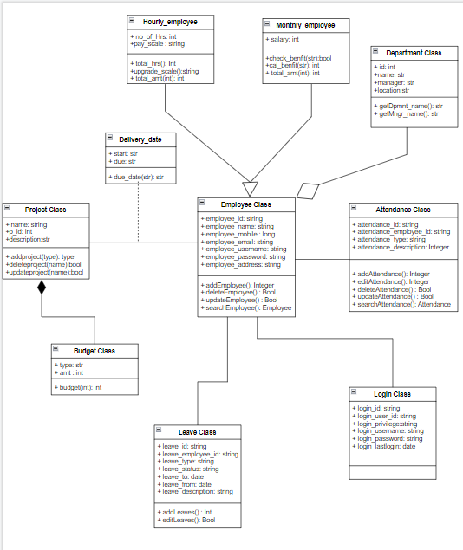

Slide 4
THANK YOU

